Slide 1
The Joy and Challenges of Writing Quality Software
Catalin Tudor

Slide 2
Challenges
“Ability is nothing without opportunity.”
—Napoleon Bonaparte, emperor of France 1804–1815

Slide 3
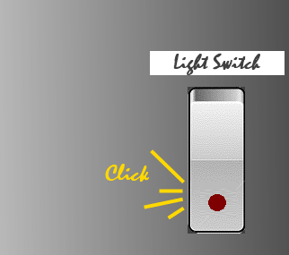
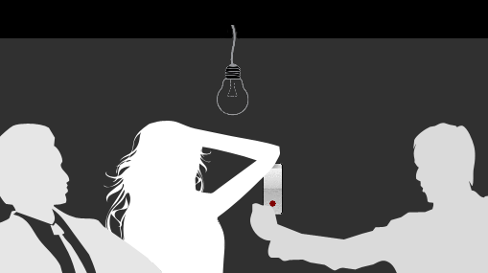
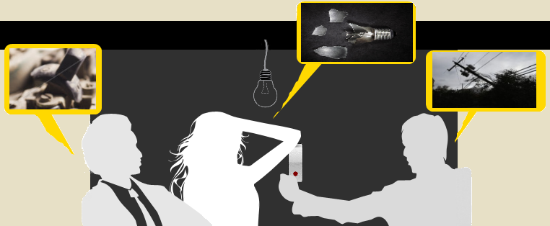
What problems are we meant to be solving?

Slide 4
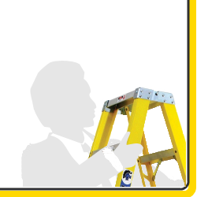
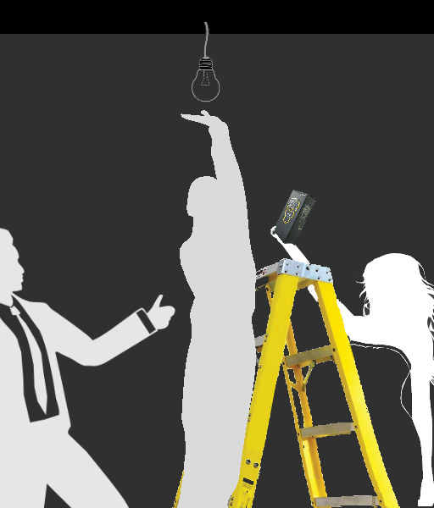
How do we work better as a team?

Slide 5
How do we innovate?

Slide 6
How do we keep our customers happy?

Slide 7
Enjoyment
“Anything you’re good at contributes to happiness.”
—Bertrand Russell, philosopher, mathematician, and historian

Slide 8
Bubble Wrapper Activity

Slide 9
Criteria for enjoyment?
There are clear goals every step of the way
There is immediate feedback to one’s actions
There is a balance between challenges and skills
Action and awareness are merged
Distractions are excluded from consciousness
There is no worry of failure
Notes:
Start with bubble wrapper example – De ce aproape tuturor ne place acest mod de a petrece timpul? Pentru ca exista aceste criterii (obiective clare, feedback imediat, am skill-uri necesare, nu sunt distras, nu mi-e teama de un posibil esec)
Stiu ca pare incredibil dar in spatele acestui mod de a petrece timpul se afla o disciplina. Ea nu este imediat vizibla dar aceste criterii sunt dovada existentei ei, ea le genereaza.
Pentru a ne face placere modul de lucru trebuie sa semene cu acest bubble wrapping popper process.
Placere care se ridica dincolo de limbaj de programare sau tip de proiect (disciplina care se ridica deasupra)
Parsare
Cod optim
Didactice

Slide 10
Software Quality and Test-Driven Development
“Great things are done by a series of small things brought together.”
—Vincent van Gogh, painter
Notes:
De ce avem nevoie de o astfel de disciplina?
Limbajele de programare sunt foarte flexibile
Proiecte creeate in limbaje multiple care ruleaza pe platforme multiple
Toate acestea conduc foarte usor catre haos. (poate poza cu un setup complicat)

Slide 11
Software Quality
External Quality (EQ)
Focus on Functional Specifications
Internal Quality (IQ)
Focus on Design Specifications
Notes:
Despre tipuri de teste, revenire la problema schimbarii becului cu exemplificare
Acceptance: setarea comutatorului pe ON trebuie sa porneasca becul
Integration: doua becuri de diferite dimensiuni sunt verificate daca se potrivesc in fasung
Unit: verificarea becului, daca functioneaza prin teste cu voltmetrul
- Cateva cuvinte generale si mai aproape de viata de zi cu zi (pe slide)
- A scrie o aplicatie de la zero e o oportunitate, si trebuie scrisa bine din prima zi.

Slide 12
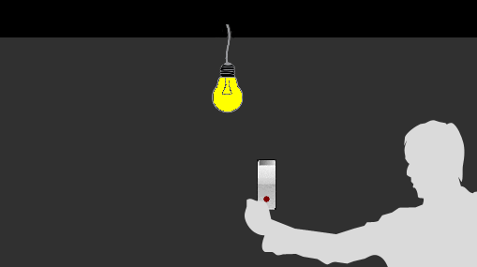
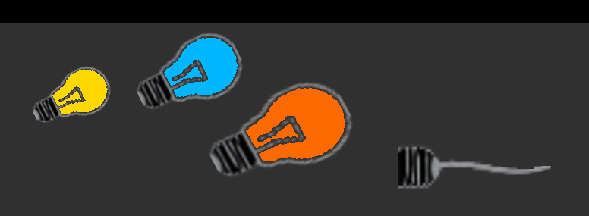
Types of tests
Acceptance Tests
Unit Tests
Integration Tests
Notes:
Modificarea pozei

Slide 13
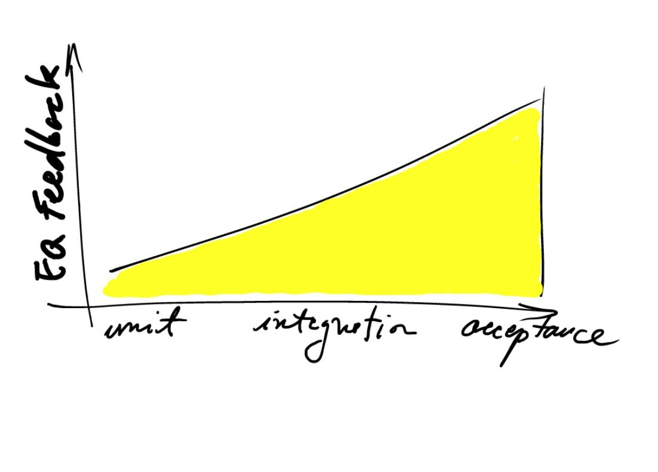
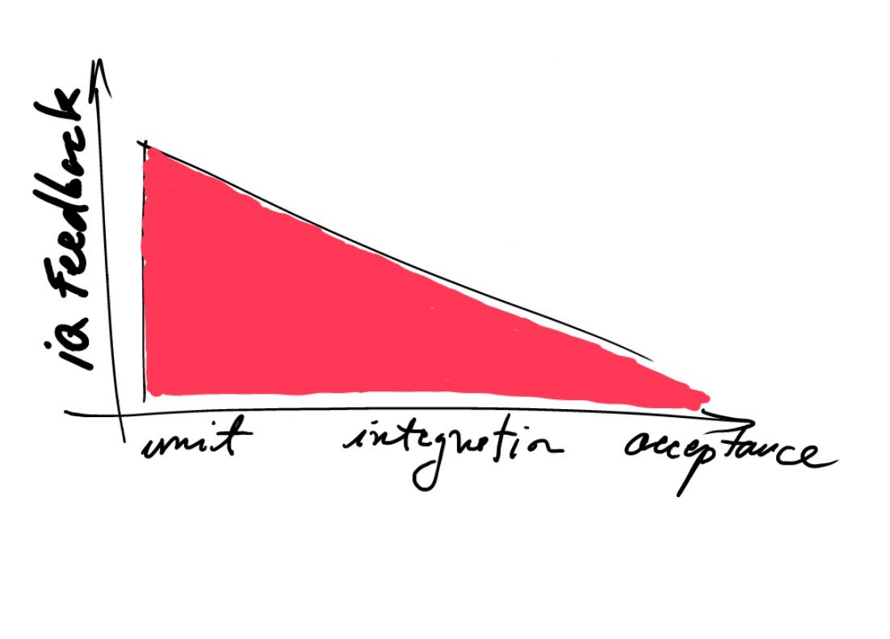
Tests and Software Quality
Notes:
Modificarea pozei

Slide 14
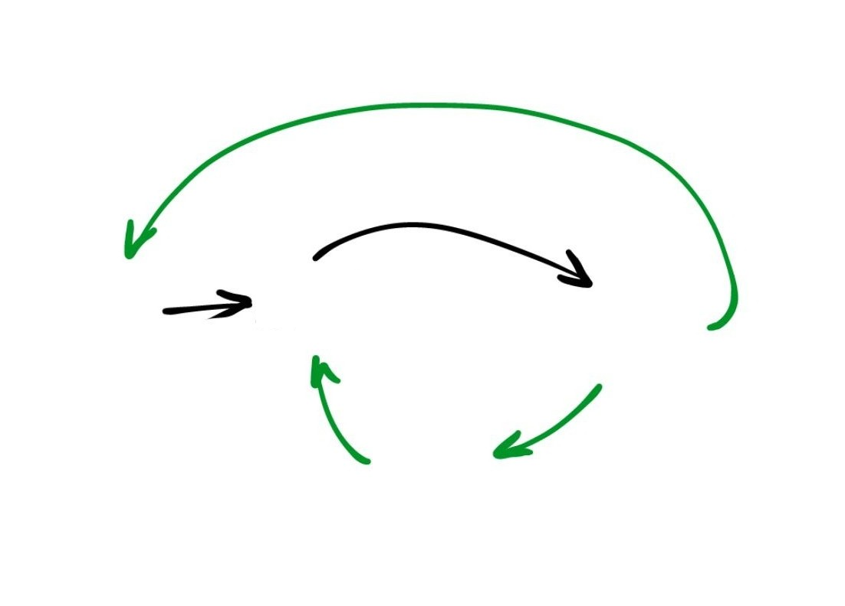
How is this done?
Acceptance test
Integration or Unit test
Code to make the test pass
Refactor

Slide 15
Learn for Fun
“I didn’t fail the test, I just found 100 ways to do it wrong.”
—Benjamin Franklin, US Founding Father

Slide 16
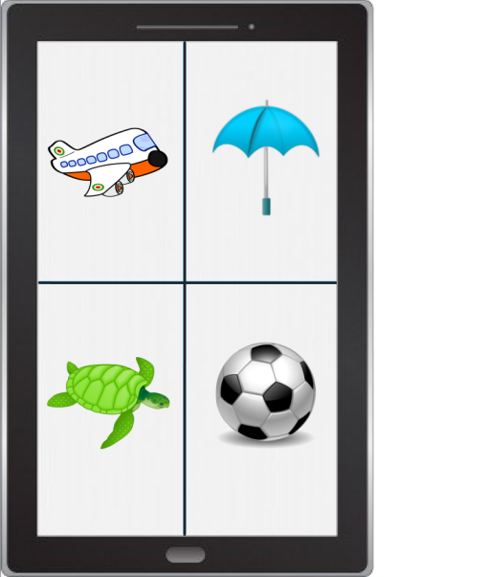
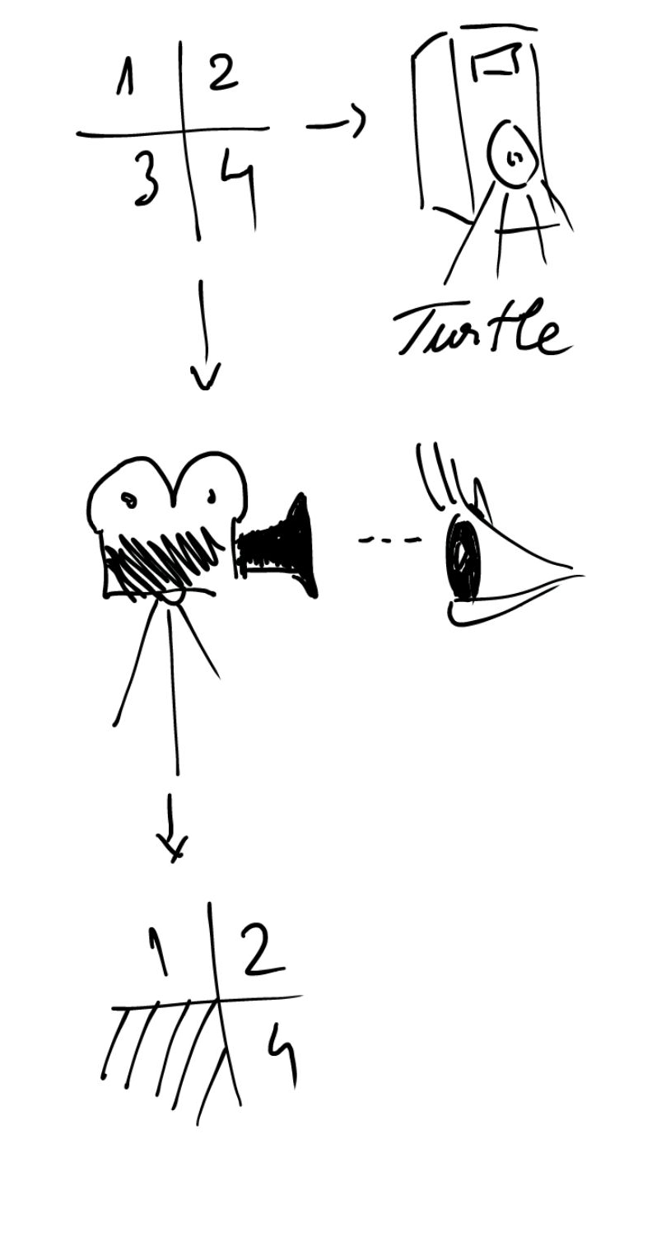
Learn for Fun
Notes:
IOS - Objective C
All - HTML + JavaScript (app in browser access la resurse limitat)
- C# (Win 8 nativ, IOS + Android -> Xamarin runtime dedicat)
Android - Java nativ
- C/C++ dar e foarte low level
Windows 8 - HTML + JavaScript
- C# + XAML
- C++ + XAML
Medii dezvoltare - Eclipse (Android Java) (ADT - Android Dev Toolkit)
- Xamarin e integrat cu VS
- pe MAC -> IOS propriul mediu de dezvoltare integrat complet

Slide 17
How to Start?
Notes:
Reduce slide count for how to start to 3

Slide 18
How to start?
Concentrate on External Quality
Identify use-cases
Prioritize them

Slide 19
Learn for Fun
Presented with a set of 4 images Dennis is able to choose one image by looking at it
Presented with a set of 4 images + a spoken word Dennis can find out if the chosen image matches the spoken word
At any time Dennis can find out whether his new language skills are improving

Slide 20
How to start?
Create a test project
Add the solution to source control
Setup a continuous integration
Automated build
Automated testing
Create installer

Slide 21
How to Continue?

Slide 22
How to continue?
Expand use-cases into scenarios
Start with the most simple scenario
Continue to add scenarios
Order them by complexity
Notes:
Desen

Slide 23
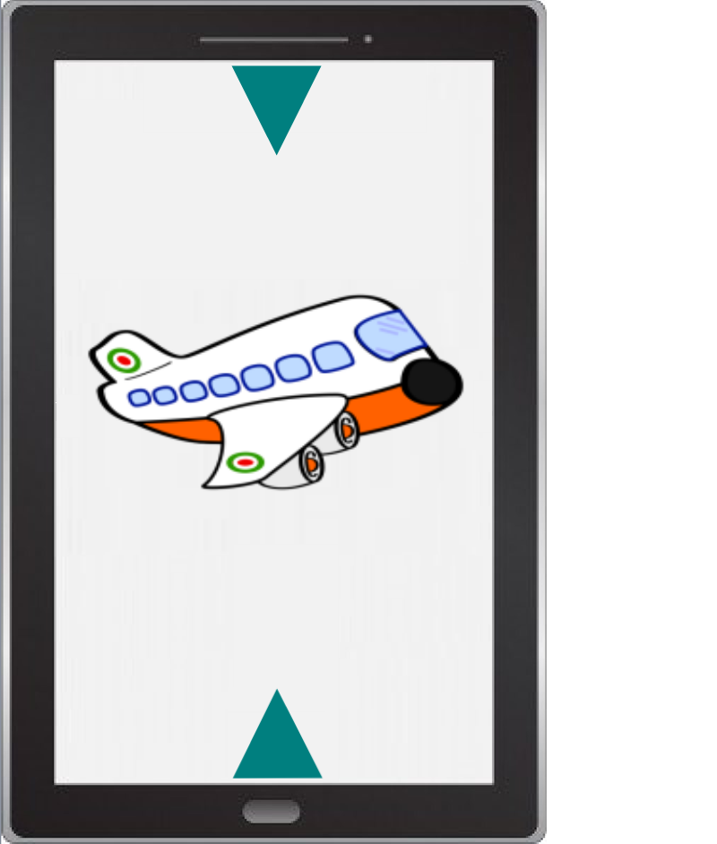
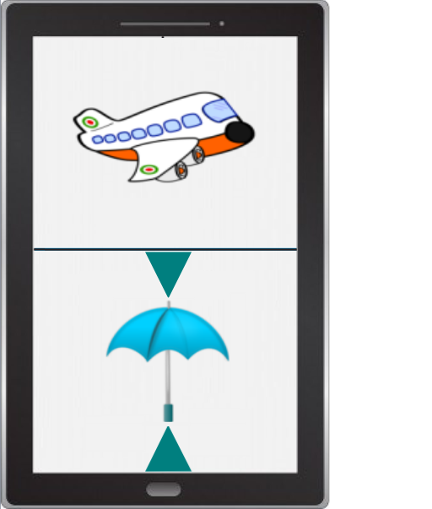
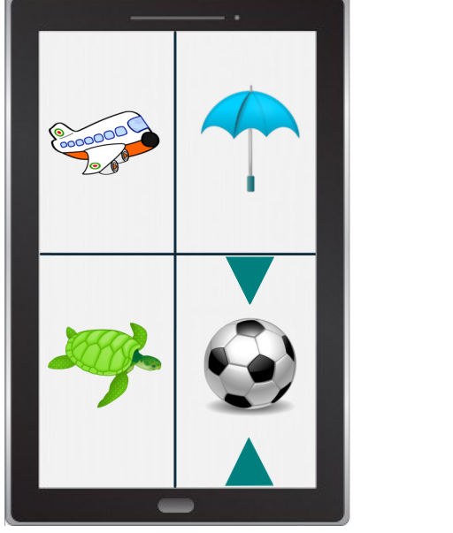
Imagine Scenarios
Presented with a set of 4 images Dennis can choose one image by looking at it

Slide 24
Imagine Scenarios
Presented with a set of 4 images + a spoken word Dennis can find out if the chosen image matches the spoken word




Slide 25
How to Continue?
Step back for a while and look at Internal Quality
Create a high level design
Use scenarios to identify main modules
There are two types of scenarios
Some drive the design
Others exercise the design
Each scenario will have an Acceptance test
Notes:
Poate un desen ar fi mai potrivit

Slide 26
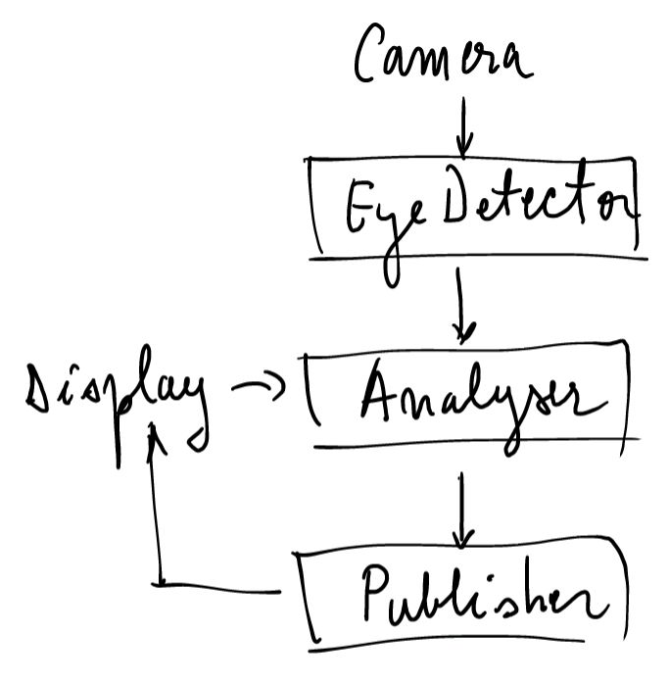
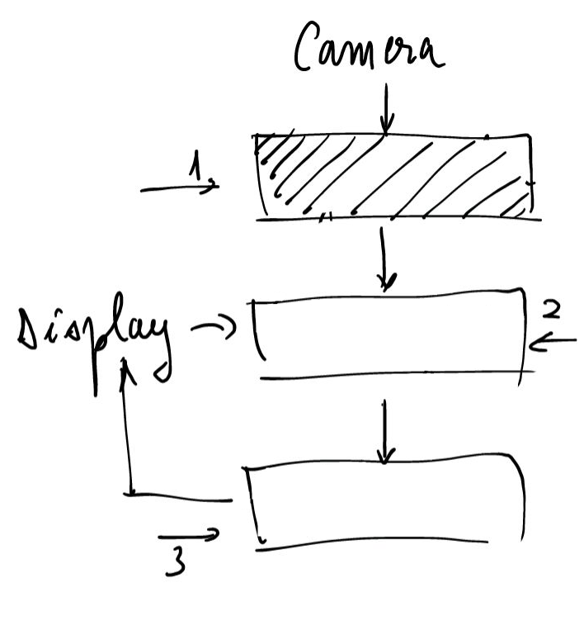
High Level Design
!

Slide 27
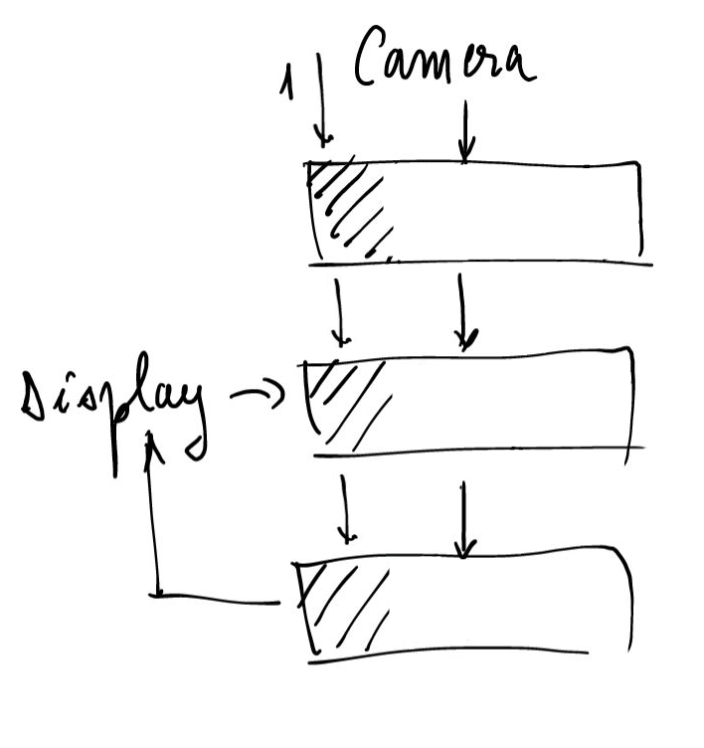
High Level Design

Slide 28
Implement Scenarios



Slide 29
How to Get it Done?

Slide 30
How to Get it Done?
Quality Assurance & Requirements Analysts are involved and steer the application towards the targeted External Quality
Every time a scenario is declared implemented it means
Much of the functionality has already been tested
QA can start a more thorough validation without waiting for Feature Complete
You know you are done when all Acceptance tests pass

Slide 31
Perspectives
How can I help?

Slide 32
Resources
Growing Object-Oriented Software Guided by Tests, Steve Freeman & Nat Pryce
Creativity: Flow and the Psychology of Discovery and Invention, Mihaly Csikszentmihalyi
101 Design Ingredients To Solve Big Tech Problems, Eewei Chen
Object Mentor http://www.objectmentor.com
Pragmatic Programmer http://www.pragprog.com

