Slide 2
Perspectives on Design Principles – Semantic Invariants and Design Entropy
Catalin Tudor

Slide 3
Liskov Substitution
If for each object o₁ of type S there is an object o₂ of type T such that for all programs P defined in terms of T, the behavior of P is unchanged when o₁ is substituted for o₂ then S is a subtype of T.

Slide 4
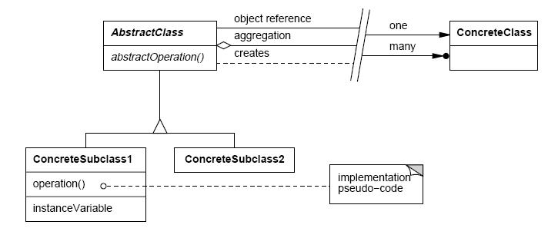
Notations

Slide 5
Imagine
You’ve created an application that was successfully deployed
Your application knows how to handle rectangles
Users ask that it should also manage squares

Slide 6
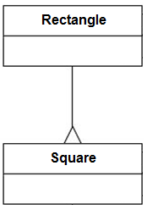
A design choice
Square is a rectangle for all normal intents
Inheritance is an ISA relationship
ISA relationship is one of the fundamental concepts of OOA

Slide 7
A design choice
class Rectangle
{
public:
void SetWidth(double w) { width = w; }
double GetWidth() const { return width; }
void SetHeight(double h) { height = h; }
double GetHeight() const { return height; }
private:
double height;
double width;
};
void Square::SetWidth(double w)
{
Rectangle::SetWidth(w);
Rectangle::SetHeight(w);
}
void Square::SetHeight(double h)
{
Rectangle::SetHeight(h);
Rectangle::SetWidth(h);
}

Slide 8
What is wrong?
Square class uses a member that is not needed (unnecessary memory)
You have to override certain access methods, this seems to break encapsulation
Functions that don’t fail with Rectangles might fail with Squares
Behaviorally, a Square is not a Rectangle and it is behavior that software is really all about
It’s generally accepted that it’s not possible to detect a Liskov Substitution violation for a class in isolation

Slide 9
Semantic Invariants

Slide 10
Constraints
Pre-conditions
Post-conditions
Invariants

Slide 11
Rectangle constraints (SetHeight)
Pre-conditions
Height needs to be a positive integer
And in a predefined range (between 1 and 1000)
Post-conditions
The rectangle will have the specified height
Invariants
Width remains unchanged

Slide 12
Rules
Pre-conditions cannot be strengthened in a subtype
Post-conditions cannot be weakened in a subtype
Invariants of the supertype must be preserved in a subtype

Slide 13
Design Entropy

Slide 14
Entropy (information theory)
Shannon entropy is a measure of the uncertainty associated with a random variable
Shannon entropy is typically measured in bits (base 2), nats (base e), bans (base 10)
A single toss of a fair coin has an entropy of one bit
Notes:
Ask people what is the definition of a bit. The usual reaction is first of certainty but they can’t formulate an answer and begin to think: “I really thought I knew the definition”.
A bit represents the minimum amount of information required to choose between two propositions having the same probability of being true.

Slide 15
Definition
.
For a random variable X with n outcomes (x₁, x₂, x₃…, x_{n}) the Shannon entropy is:
$$H\left(X\right)=−\sum_{i=1}^{n}{p(x_{i})\log_{b}{p(x_{i})}}$$
where
$$p\left(x_{i}\right)$$
is the probability of the outcome
$$x_{i}$$

Slide 16
Example
.
How much information is required to store
X = {0, 1}. Consider $p\left(x_{i}\right)=\frac{1}{2}$ ?
$$H\left(X\right)=−\sum_{i=1}^{2}{\frac{1}{2}\log_{2}{\frac{1}{2}}}$$
= 1 (bit)

Slide 17
Example
.
How much information is required for
X = {00, 01, 10, 11}? Consider $p\left(x_{i}\right)=\frac{1}{4}.$
$$H\left(X\right)=−\sum_{i=1}^{4}{\frac{1}{4}\log_{2}{\frac{1}{4}}}$$
= 2 (bits)

Slide 18
Class Entropy - Rectangle
.
How much information is Rectangle exposing?
We look at class fields
Width = w (0/1)
Height = h (0/1)
Rectangle is defined by a random variable
$$X_{R}=\left\{wh\right\}, { X}_{R}=\{00, 01, 10, 11\}$$
$$H(X_{R})=2$$
Notes:
How much entropy is the Rectangle class exposing?
We consider a simplified version of a rectangle where width and height can take only values 0 and 1. In this case the Rectangle class has an entropy of 2 bits.

Slide 19
Class Entropy - Square
.
How much information is Square exposing?
Width = w (0/1)
Height = h (0/1)
Width and Height are no longer independent
$$X_{S}=\left\{wh\right\}, { X}_{S}=\left\{00, 11\right\}$$
$$H(X_{s})=1$$
Notes:
How much entropy is the Square class exposing?
We consider a simplified version of a square where width and height can take only values 0 and 1. As width and height are no longer independent (we can’t set the width without setting the height also) the Square class has an entropy of 1 bit.

Slide 20
Necessary Condition for LSP
.
Whenever class S extends class R is necessary that $H\left(XS\right)≥H\left(XR\right)$
In the Square vs. Rectangle case
$$1=H(XS)<H(XR)= 2$$

Slide 21
Breaking the rules
.
What happens when the entropy rule is broken?
Let’s say we have method m using objects of type R
If class S extends class R by breaking the entropy rule then method m will have to account for the missing entropy in class S (read this as strong coupling)

Slide 22
Real world examples of what can happen when the Entropy rule is broken

Slide 23
Example 1

Slide 24
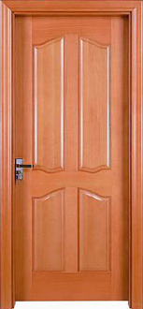
A door
Notes:
There’s a door. Yep!
What a does a door do? What is it’s behavior? Well… a door opens (it better be) and it uses the interior of a room to do it.
Here’s a simple way to write it in code:
class Door
{
void Open(Room r)
{
…. the door opens inside the room
}
}
Imagine the entropy of the room is proportional with it’s volume. What would happen if we extend the class Room by reducing it’s entropy (volume). Let’s call this new class a MiniRoom. Well… the next slide is talking for itself.

Slide 25
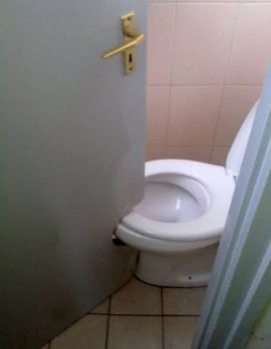
Same door in a room with less volume
Notes:
The result is this:
The missing information (entropy) in the room needs to be accounted for and gets coded into the door. Now the door and the room are strongly coupled. You can’t use this door with another room without raising some eyebrows!
With humor talk about the situation at hand where the workers probably didn’t install the toilet in the first place and the owner got really upset by this. Installing the toilet (near the project deadline) had literally ruined what looked like a good design.”

Slide 26
Example 2

Slide 27
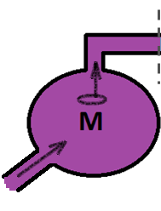
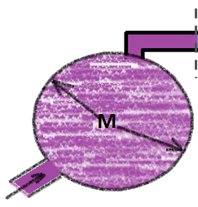
Water pump
.
Water pump model
Object instances – water tanks
Method calls – pumping water
Class entropy – tank volume
Pump m coupled with R
Now attach S

Slide 28
Practice
.
You need to create a class that stores one file system path
Examples:
/home/repository/build.doc
../../test.sh
./special_folder
You have String class at your disposal (you can either use inheritance or aggregation)

Slide 29
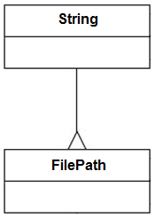
Solution 1
.
Clearly FilePath is a string
Reuse String class
Benefit for free from functionality offered by other libraries handling String objects
Breaks entropy rule: some characters are not allowed in a path ex: NUL and / some apps may not allow ?, *, :, + and %

Slide 30
Solution 2
.
FilePath is a string sometimes…
Most of the times is a FilePath
We should reuse String but only as a Strategy not as a Template
This solution allows for entropy variation in both directions

Slide 31
Design Entropy Challenges
.
Invent a way to automatically detect design flaws in existing applications based on design entropy rules
Find entropy rules for:
Open Close Principle
Dependency Inversion Principle
Interface Segregation Principle
Single Responsibility Principle
Find the correct entropy rule for aggregation / composition
Look for an entropy rules that settle the inheritance vs. aggregation debate

Slide 32
Resources
OOD articles http://www.objectmentor.com
Shannon Entropy http://en.wikipedia.org/wiki/Entropy_(information_theory)

