Slide 2
Introduction to Design Patterns

Slide 3
Agenda
Course Goal
Engineering goal
Complex systems
Raw materials
General Design
Bad design
Design principles
Design Patterns
What is a Design Pattern?
Design Pattern space (catalog)
Design Patterns details
Practice
Design a File System

Slide 4
Introduction
Course Goal

Slide 5
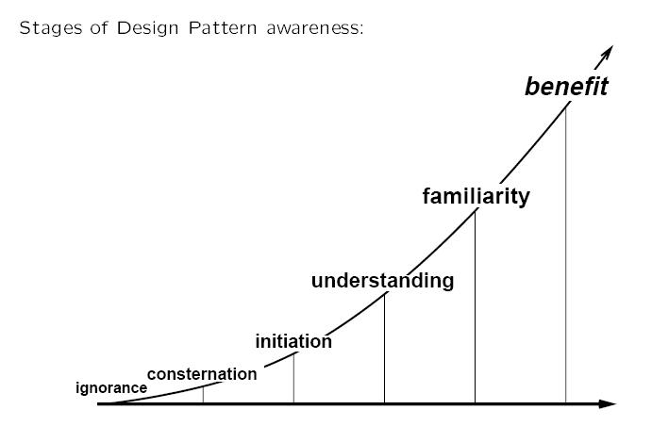
Goal

Slide 6
Introduction
Engineering Goal

Slide 7
Introduction - Engineering Goal
Build complex systems
A complex system is not complicated
Differentiated – has many distinctive parts
Integrated - the several parts work together smoothly
The market seems to favour systems that are complex; i.e., differentiated and integrated at the same time.

Slide 8
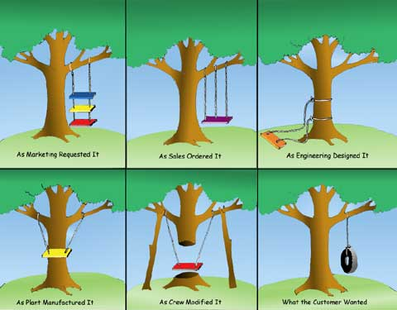
Introduction - Engineering Goal
Complicated systems

Slide 9
Introduction - Engineering Goal
Raw “materials”: materials we can use in order to build such systems
Data
Logic
Time
The “glue”
Coupling (static, dynamic, domain)
Examples of coupling
Logic-Data-Time : structured programming
(Logic-Data)_{N} –Time: single threaded OOP
((Logic-Data)_{N} –Time)_{M} : multi threading OOP

Slide 10
Introduction
General Design

Slide 11
Introduction - General Design
Characteristics of a bad design
Rigidity - every change affects too many other parts of the system
Fragility - a change causes unexpected parts of the system break
Immobility - hard to reuse in another application
Design Principles: guidelines that helps us to avoid having a bad design
Single Responsibility Principle
Open Close Principle
Liskov Substitution Principle
Interface Segregation Principle
Dependency Inversion Principle

Slide 12
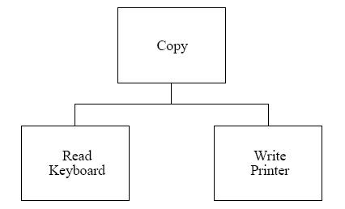
General Design – Bad Design
Example: The “Copy” Program
Responsibilities
Read characters from a keyboard
Write them to a printer
Implementation
Problem
“Copy” module is not reusable in any context that does not involve a keyboard and a printer
Goal
Reuse the “Copy” module in other situations as well (e.g. copy from keyboard and write to a disk file)

Slide 13
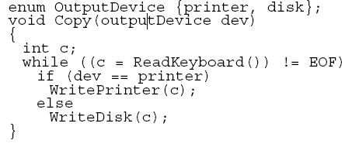
General Design – Bad Design (continued)
Solution 1
Modify the “Copy” module to give it the new functionality
This adds new interdependencies to the system
As more devices will be added, “Copy” will become rigid and fragile

Slide 14
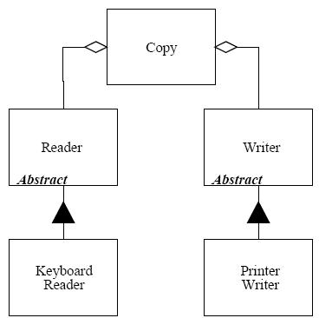
General Design – Bad Design (continued)
Solution 2
“Copy” depends upon abstractions
Now we can reuse the “Copy” module, independently of the “Keyboard Reader” and the “Printer Writer”

Slide 15
Design Principles
Single Responsibility Principle

Slide 16
Design Principles
Open Close Principle

Slide 17
Design Principles - Open Close Principle
Software entities like classes, modules and functions should be open for extension but closed for modifications
Open for Extension
The behavior of the module can be extended
New behaviors can be added
Close for Modification
The source code of such a module is untouched
New features are added by adding new code, rather than by changing old, already working, code
Conformance to this principle yields:
Reusability
Maintainability
Abstraction is the Key

Slide 18
Design Principles - Open Close Principle
Everything works for a while

Slide 19
Design Principles
Dependency Inversion Principle

Slide 20
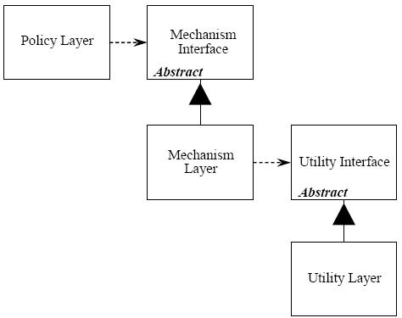
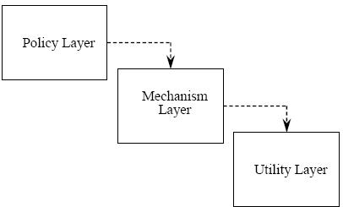
Design Principles - Dependency Inversion Principle
High-level modules should not depend on low-level modules
Both should depend upon abstractions
Abstractions should not depend on details
abstract classes should not depend upon concrete classes; concrete classes should depend upon abstract classes
Layering example

Slide 21
Design Principles
Interface Segregation Principle

Slide 22
Design Principles – Interface Segregation Principle
Clients should not be forced to depend upon interfaces that they do not use
Add only methods that should be in an interface
..otherwise the classes implementing the interface will have to implement those methods as well
Example: Worker interface
Has “lunch break” method
What if the worker is a robot?

Slide 23
Design Principles
Liskov’s Substitution Principle

Slide 24
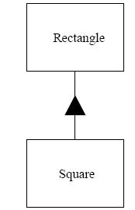
Design Principles – Liskov’s Substitution Principle
Derived types must be completely substitutable for their base types
new derived classes should be able to replace the base classes without any change in the code
Example: Square - Rectangle

Slide 25
Introduction
Design Patterns GoF (Erich Gamma, Richard Helm, Ralph Johnson, John Vlissides)

Slide 26
Practical exercise
Design a File System

Slide 27
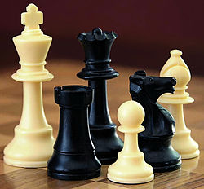
Design Patterns – What is a Design Pattern
A design pattern is not a template—at least not in the sense of a dressmaker’s template, or a woodworker’s pattern
It is not a recipe. You can’t just add ingredients and stir mindlessly to achieve a finished product
So what is it?

Slide 28
Design Patterns - What is a Design Pattern
A design pattern shouldn’t provide you with a solution, but it should inspire a solution
Using Design Patterns
Can speed up the development process by providing tested, proven development solutions
Improves code readability for coders and architects familiar with the patterns
Allows developers to communicate using well-known, well understood names for software interactions

Slide 29
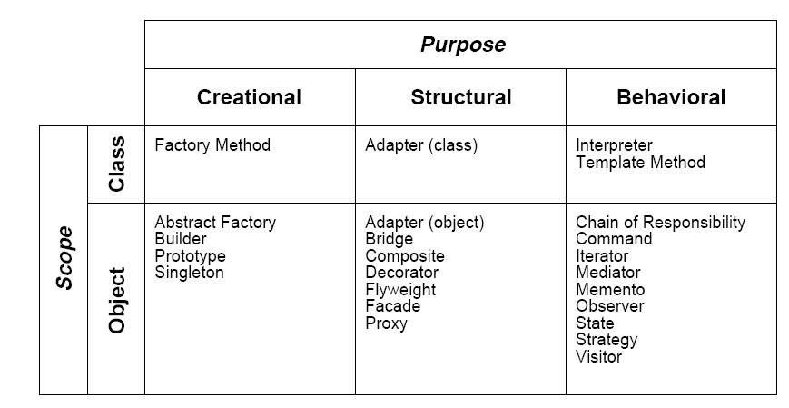
Design Patterns - Catalog

Slide 30
Design Patterns – Catalog (continued)
Creational Patterns
Abstract the instantiation process
Help make a system independent of how its objects are created, composed, and represented
Structural Patterns
Describe how classes and objects are composed to form larger, more complex structures
Behavioral Patterns
Describe ways to handle algorithms and ways of communication between objects

Slide 31
Design Patterns - Template
GoF uses the following template to describe a Pattern:
Intent
short description of pattern and its purpose
Also Known As
name alias
Motivation
motivating scenario demonstrating pattern's use
Applicability
circumstances in which pattern applies
Structure
graphical representation of the pattern
Participants
participating classes and/or objects and their responsibilities

Slide 32
Design Patterns – Template (continued)
Collaborations
how participants cooperate to carry out their responsibilities
Consequences
the results of application, benefits, liabilities
Implementation
implementation pitfalls, hints, or techniques, plus any language-dependent
issues
Sample Code
Known Uses
Related Patterns

Slide 33
Design Patterns
Notations

Slide 34
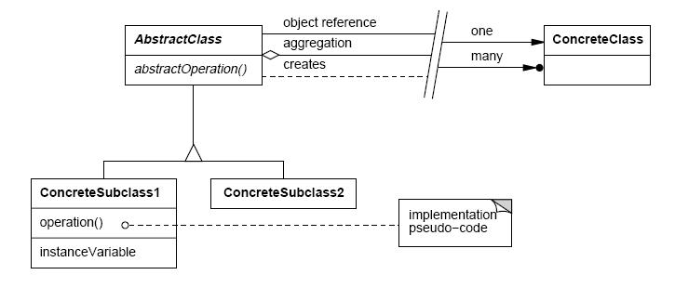
Notations

Slide 35
Design Patterns
Pattern Presentation

Slide 36
Pattern Presentations
Composite
Iterator
Strategy
State
Template Method
Decorator
Proxy
Factory Method
Visitor
Abstract Factory
Observer
Command
Adapter
Facade
Singleton
Bridge

Slide 37
Composite (structural)

Slide 38
Composite
Intent
Compose objects into tree structures
Treat individual objects and compositions of objects uniformly

Slide 39
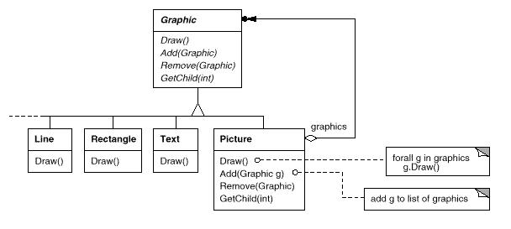
Composite - Motivation
Example: Graphics applications such as drawing editors
build complex diagrams out of simple components

Slide 40
Composite - Applicability
Use the Composite pattern when:
You want to represent hierarchies of objects
There should be no distinction between individual and composed elements,
Objects in the structure can be treated uniformly

Slide 41
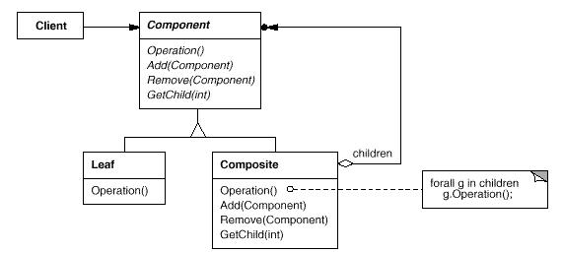
Composite - Participants
Component (Graphic)
declares the interface for objects in the composition
Leaf (Rectangle, Line, Text, etc.)
represents leaf objects in the composition. A leaf has no children
defines behavior for primitive objects in the composition

Slide 42
Composite – Participants (continued)
Composite (Picture)
defines behavior for components having children
stores child components
implements child-related operations in the Component interface
Client
manipulates objects in the composition through the Component interface

Slide 43
Composite - Collaborations
Clients use the Component class interface to interact with objects in the composite structure
If the recipient is a Leaf, then the request is handled directly
If the recipient is a Composite, then it usually forwards requests to its child components

Slide 44
Composite – Consequences
Defines class hierarchies consisting of primitive objects and composite objects
Primitive objects can be composed into more complex objects
… which in turn can be composed
… and so on recursively
Wherever client code expects a primitive object, it can also take a composite object
Makes the client simple
Clients don't know whether they're dealing with a leaf or a composite component
Makes it easier to add new kinds of components
Clients don't have to be changed for new Component classes
Can make your design overly general
Sometimes you want a composite to have only certain types of components

Slide 45
Iterator (behavioral)

Slide 46
Iterator
Intent
Provide a way to access the elements of an aggregate object sequentially without exposing its underlying representation
Also Known As
Cursor

Slide 47
Iterator - Motivation
Example
List
Goal
Access List’s elements without exposing its internal structure
Allow different traversal types
Allow multiple traversals at the same time
Solution
Move the traversal into a separate, Iterator object

Slide 48
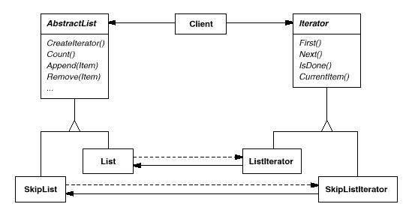
Iterator – Motivation (continued)
Two class hierarchies, one for lists and another for iterators
CreateIterator method "connects" the two hierarchies

Slide 49
Iterator - Applicability
Use the Iterator pattern to:
access an aggregate object's contents without exposing its internal representation
support multiple traversals of aggregate objects
provide a uniform interface for traversing different aggregate structures

Slide 50
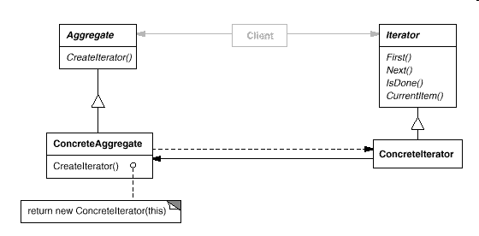
Iterator - Participants
Iterator
defines an interface for accessing and traversing elements
ConcreteIterator
implements the Iterator interface
keeps track of the current position in the traversal of the aggregate

Slide 51
Iterator – Participants (continued)
Aggregate
defines an interface for creating an Iterator object
ConcreteAggregate
implements the Iterator creation interface to return an instance of the proper ConcreteIterator

Slide 52
Iterator – Collaborations
A ConcreteIterator keeps track of the current object in the aggregate
Can compute the succeeding object in the traversal

Slide 53
Iterator – Consequences
Supports variations in the traversal of an aggregate
Forwards, backwards etc.
Iterators simplify the Aggregate interface
More than one traversal can be pending on an aggregate

Slide 54
Iterator - Implementation
Who controls the iteration?
External Iterators
Internal Iterators – client provides an operation to be executed
Additional Iterator operations
Previous, SkipTo(criteria) etc.
Iterators may have privileged access
Could use friend directives in C++
Tight coupling
Iterators for composites
External: difficult; need to store full path inside the composite
Internal: easier; calls itself recursively

Slide 55
Strategy (behavioral)

Slide 56
Strategy
Intent
Define a family of algorithms
Allow clients to choose between algorithms
“Strategy” – term for an encapsulated algorithm
Known As
Policy
Motivation
Supporting multiple date formats (e.g. 10/2/05 , 2 Oct 2005 etc.)
Supporting multiple traversal types for a collection

Slide 57
Strategy - Applicability
Use the Strategy pattern when:
Many related classes differ only in their behavior
You need different variants of an algorithm
Multiple behaviors defined within conditionals

Slide 58
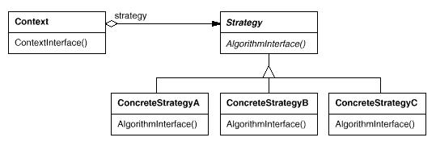
Strategy - Participants
Strategy
declares an interface common to all supported algorithms
Context uses this interface to call the algorithm defined by a ConcreteStrategy
ConcreteStrategy
implements the algorithm using the Strategy interface

Slide 59
Strategy– Participants (continued)
Context
is configured with a ConcreteStrategy object
maintains a reference to a Strategy object

Slide 60
Strategy - Collaborations
A context forwards requests from its clients to its strategy
Clients usually create and pass a ConcreteStrategy object to the context

Slide 61
Strategy– Consequences
Strategies eliminate conditional statements
Allows changing algorithms at run time
A choice of implementations
Clients can be aware of different Strategies (domain coupling)
A client must understand how Strategies differ before it can select the appropriate one
Clients might be exposed to implementation issues
Clients are not aware of different Strategies (no domain coupling)
A client doesn’t understand what different Strategies are, instead is configured to use a specific Strategy

Slide 62
Visitor (behavioral)

Slide 63
Visitor
Intent
Represent an operation to be performed on the elements of an object structure
Allows defining a new operation without changing the classes of the elements on which it operates

Slide 64
Visitor – Motivation - AST (abstract syntax tree)
Example: Compiler
Represents programs as abstract syntax trees
Goal
Allow different operations to be applied on the AST nodes (e.g. type-checking, flow analysis, pretty-printing etc.)
Problem
Not every operation makes sense for each node type
Solution
Package related operations from each class in a separate object, called a visitor
Pass it to elements of the AST as it's traversed

Slide 65
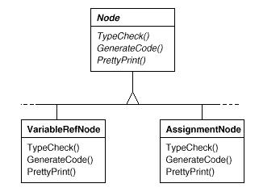
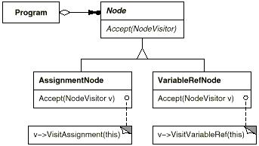
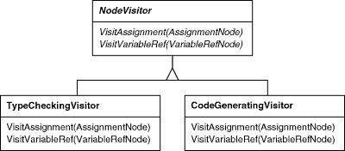
Visitor – Motivation (continued)
Inflexible approach
Some operations don’t have sense on all the Node subclasses
Hard to maintain and understand

Slide 66
Visitor - Applicability
Use the Visitor pattern when:
an object structure contains many classes of objects with differing interfaces, and you want to perform operations on these objects that depend on their concrete classes
many distinct and unrelated operations need to be performed on objects in an object structure
… you want to avoid "polluting" their classes with these operations
the classes defining the object structure rarely change, but you often want to define new operations over the structure

Slide 67
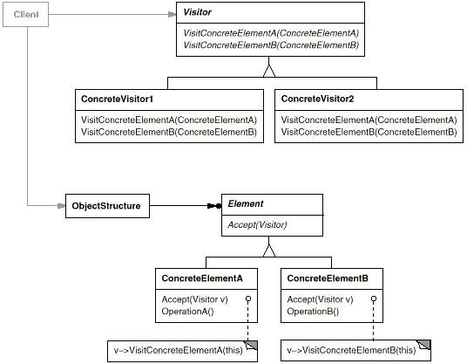
Visitor - Participants
Visitor (NodeVisitor)
declares a Visit operation for each class of ConcreteElement
ConcreteVisitor (TypeCheckingVisitor)
implements each operation declared by Visitor

Slide 68
Visitor – Participants (continued)
Element (Node)
defines an Accept operation that takes a visitor as an argument
ConcreteElement (AssignmentNode,VariableRefNode)
implements an Accept operation
ObjectStructure (Program)
May be a collection such as a list or a set
can enumerate its elements
may provide a high-level interface to allow the visitor to visit its elements

Slide 69
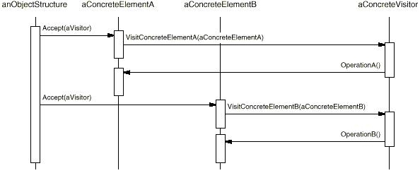
Visitor - Collaborations
Create a ConcreteVisitor object and visit each element in the collection
Visited element calls the Visitor operation that corresponds to its class
The element supplies itself as an argument to the operation to let the visitor access its state (if necessary)

Slide 70
Visitor – Consequences
Visitor makes adding new operations easy
Define a new operation over an object structure simply by adding a new visitor
Otherwise you must change each class to define a new operation
Accumulating state
Visitors can accumulate state as they visit each element in the object structure
Breaking encapsulation
the pattern often forces you to provide public operations that access ConcreteElement’s internal state
Adding new ConcreteElement classes is hard
Each new ConcreteElement gives rise to a new abstract operation on Visitor
… and a corresponding implementation in every ConcreteVisitor class

Slide 71
Visitor - Implementation
Double dispatch - which operation will fulfill a request ?
Single dispatch criteria: the name of the request and the type of receiver
Double Dispatch criteria: the name of the request and the types of two receivers
Who is responsible for traversing the object structure?
Visitor must visit each element of the object structure
Responsibility for traversal in any of three places:
in the object structure (e.g. Composite)
in the visitor – reason: implement a complex traversal, one that depends on the results of the operations on the object structure
in a separate iterator object

Slide 72
State (behavioral)

Slide 73
State
Intent
An object-oriented state machine
Allow an object to alter its behavior when its internal state changes

Slide 74
State - Motivation
Example: TCP Connection
A TCPConnection object can be in one of several different states
Established
Listening
Closed
Responds differently to requests depending on its current state
Problem
Monolithic approaches include large and numerous case statements
Solution
Use an abstract class called TCPState to represent the states of the network connection

Slide 75
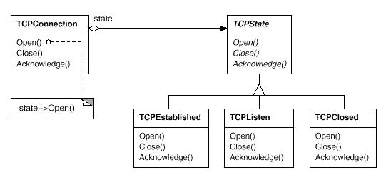
State – Motivation (continued)

Slide 76
State - Applicability
Object behavior depends on its state, and it must change its behavior at run-time depending on that state
Operations have large, multipart conditional statements that depend on the object's state
State pattern puts each branch of the conditional in a separate class

Slide 77
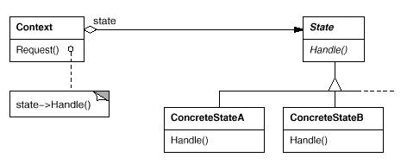
State - Participants
Context (TCPConnection)
defines the interface of interest to clients
maintains an instance of a ConcreteState subclass that defines the current state
State (TCPState)
defines an interface for encapsulating the behavior associated with a particular state of the Context

Slide 78
State – Participants (continued)
ConcreteState (TCPEstablished, TCPListen, TCPClosed)
each subclass implements a behavior associated with a state of the Context

Slide 79
State - Collaborations
Context delegates state-specific requests to the current ConcreteState object
A context may pass itself as an argument to the State object
Context is the primary interface for clients
Clients can configure a context with State objects
Once a context is configured, its clients don't have to deal with the State objects directly
Either Context or the ConcreteState subclasses can decide which state succeeds another

Slide 80
State – Consequences
It localizes state-specific behavior and partitions behavior for different states
New states and transitions can be added easily by defining new State subclasses
Increased number of classes

Slide 81
State - Implementation
Who defines the state transitions?
The Context
only if transition criteria are fixed
The State subclasses
More flexible and appropriate
Context must provide API to set the next state
State subclass will have knowledge of at least one other

Slide 82
Template Method (behavioral)

Slide 83
Template Method
Intent
Define the skeleton of an algorithm in an operation, deferring some steps to client subclasses

Slide 84
Template Method - Motivation
Example: Framework that provides Application and Document classes
Context
Application – responsible for opening documents stored in an external format
Goal
Reuse the “Document Open” algorithm
Let different Application subclasses “customize” this algorithm
Solution
Implement the algorithm function in terms of virtual functions (customization points)

Slide 85
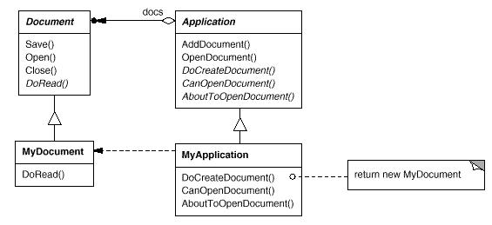
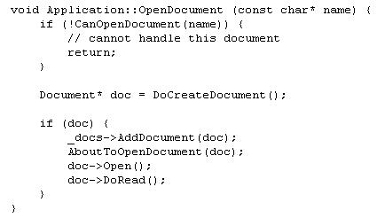
Template Method – Motivation (continued)

Slide 86
Template Method - Applicability
Use the Template Method pattern:
to implement the invariant parts of an algorithm once and leave it up to subclasses to implement the behavior that can vary
to control subclasses extensions (permit extensions only at certain points)

Slide 87
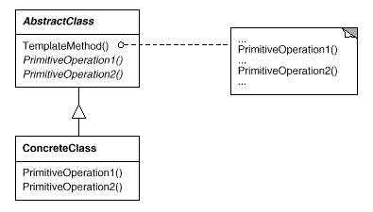
Template Method - Participants
AbstractClass (Application)
defines the primitive operations
implements a template method defining the skeleton of an algorithm
ConcreteClass (MyApplication)
implements the primitive operations to carry out subclass-specific steps of the algorithm

Slide 88
Template Method - Collaborations
ConcreteClass relies on AbstractClass to implement the invariant steps of the algorithm

Slide 89
Template Method – Consequences
Leads to inversion of control (“Hollywood principle": don't call us, we'll call you)
Promotes code reuse
Must subclass to specialize behavior

Slide 90
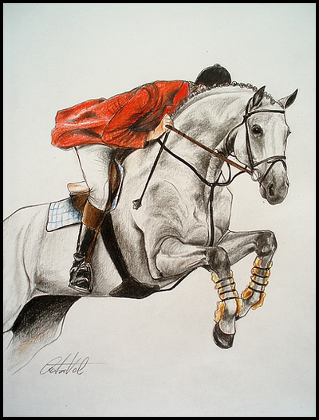
VI – VIII Century Technological Invention

Slide 91
Decorator (structural)

Slide 92
Decorator
Intent
Attach additional responsibilities to an object dynamically
Decorators provide a flexible alternative to subclassing for extending functionality
Add responsibilities to individual objects, not to an entire class
Wrapping a gift, putting it in a box, and wrapping the box
Known As
Wrapper

Slide 93
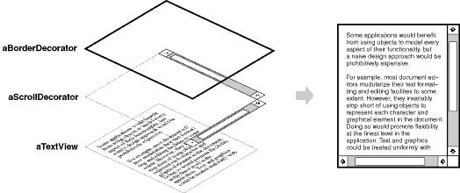
Decorator - Motivation
Example: A graphical user interface toolkit
should let you add properties like borders or behaviors like scrolling to any user interface component
One way to add responsibilities is with inheritance
A more flexible approach is to enclose the component in another object that adds new properties

Slide 94
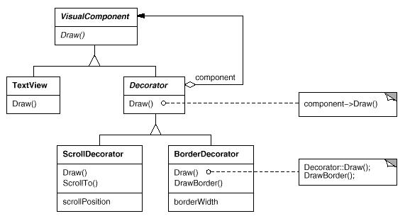
Decorator – Motivation (continued)

Slide 95
Decorator - Applicability
Use the Decorator pattern when:
You want to add responsibilities to individual objects dynamically
Responsibilities can be withdrawn
Extension by subclassing is impractical

Slide 96
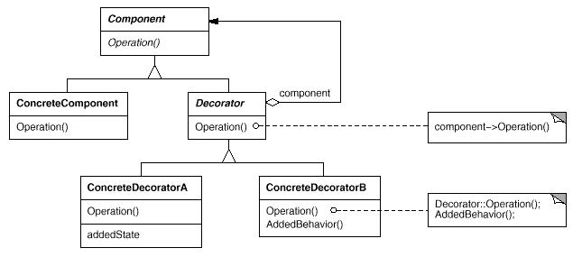
Decorator - Participants
Component (VisualComponent)
defines the interface for objects that can have responsibilities added to them dynamically
ConcreteComponent (TextView)
defines an object to which additional responsibilities can be attached

Slide 97
Decorator – Participants (continued)
Decorator
maintains a reference to a Component object and defines an interface that conforms to Component's interface
ConcreteDecorator (BorderDecorator, ScrollDecorator)
adds responsibilities to the component

Slide 98
Decorator - Collaborations
Decorator forwards requests to its Component object
May optionally perform additional operations before and after forwarding the request

Slide 99
Decorator – Consequences
More flexibility than static inheritance
With decorators, responsibilities can be added and removed at run-time
Inheritance requires creating a new class for each additional responsibility (e.g., BorderedScrollableTextView, BorderedTextView)
Decorators also make it easy to add a property twice (e.g. double border)
Lots of little objects
Lots of little objects that all look alike
Can be hard to learn and debug

Slide 100
Imagine

Slide 101
Proxy (structural)

Slide 102
Proxy
Intent
Provide a placeholder for another object to control access to it
Use an extra level of indirection to support controlled access
Also Known As
Surrogate

Slide 103
Proxy - Motivation
Create expensive objects on demand
Example: Document editor that can embed graphical objects
Problem
Some graphical objects, like large images, can be expensive to create
Goal
opening a document should be fast
not all of these objects will be visible in the document at the same time
Solution
avoid creating all the expensive objects at once when the document is opened
use another object, an image proxy, that acts as a stand-in for the real image

Slide 104
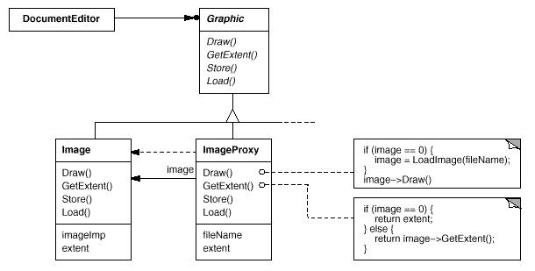
Proxy - Motivation

Slide 105
Proxy - Applicability
Remote proxy
local representative for an object in a different address space
Virtual proxy
creates expensive objects on demand
Protection proxy
controls access to the original object (e.g. objects should have different access rights )
Smart pointer
replacement for a bare pointer
Copy on write
postpone the copying process until the object is modified

Slide 106
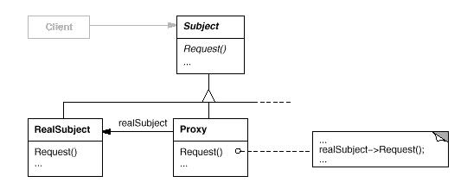
Proxy - Participants
Proxy (ImageProxy)
maintains a reference to the real object (subject)
provides an interface identical to Subject's
controls access to the real subject (may be responsible for creating and deleting it)
Subject (Graphic)
defines the common interface for RealSubject and Proxy

Slide 107
Proxy – Participants (continued)
RealSubject (Image)
defines the real object that the proxy represents

Slide 108
Proxy - Collaborations
Proxy forwards requests to RealSubject when appropriate
depending on the kind of proxy

Slide 109
Proxy – Consequences
Proxy pattern introduces a level of indirection when accessing an object
remote proxy can hide the fact that an object resides in a different address space
virtual proxy can perform optimizations such as creating an object on demand
protection proxies and smart references allow additional housekeeping tasks when an object is accessed

Slide 110
Factory Method (creational)

Slide 111
Factory Method
Intent
Define an interface for creating an object, but let subclasses decide which class to instantiate
Defer instantiation to subclasses
Refers to the newly created object through a common interface
Known As
Virtual Constructor

Slide 112
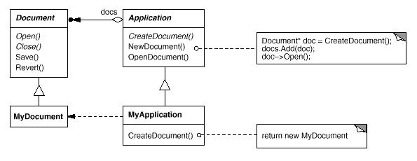
Factory Method– Motivation
Framework for applications that can present multiple documents to the user
Examples: Iterator, Template Method

Slide 113
Factory Method - Applicability
Use the Factory Method pattern when:
a class can't anticipate the class of objects it must create
a class wants its subclasses to specify the objects it creates

Slide 114
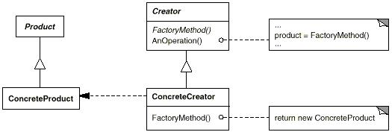
Factory Method - Participants
Product (Document)
defines the interface of objects the factory method creates
ConcreteProduct (MyDocument)
implements the Product interface

Slide 115
Factory Method– Participants (continued)
Creator (Application)
declares the factory method, which returns an object of type Product
may call the factory method to create a Product object
ConcreteCreator (MyApplication)
overrides the factory method to return an instance of a ConcreteProduct

Slide 116
Factory Method - Collaborations
Creator relies on its subclasses to define the factory method so that it returns an instance of the appropriate ConcreteProduct

Slide 117
Factory Method– Consequences
Provides hooks for subclasses
Factory Method gives subclasses a hook for providing an extended version of an object
More flexible than creating an object directly
Connects parallel class hierarchies
See Iterator

Slide 118
Abstract Factory (creational)

Slide 119
Abstract Factory
Intent
Factory of factories

Slide 120
Abstract factory - Motivation

Slide 121
Abstract factory - Motivation
Support for multiple Look and Feel standards

Slide 122
Abstract factory – Motivation (continued)

Slide 123
Abstract Factory - Applicability
Use the Abstract Factory pattern when
a system should be configured with one of multiple families of products.
a system should be independent of how its products are created, composed, and represented.
a family of related product objects is designed to be used together, and you need to enforce this constraint.

Slide 124
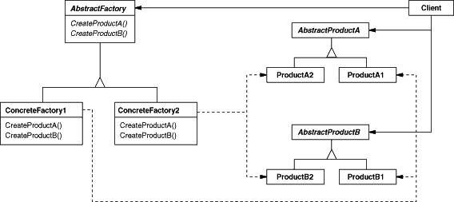
Abstract Factory - Participants
Abstract Factory (WidgetFactory)
declares an interface for operations that create abstract product objects
Concrete Factory (MotifWidgetFactory, PMWidgetFactory)
implements the operations to create concrete product objects
Abstract Product (Window, ScrollBar)
declares an interface for a type of product object

Slide 125
Abstract Factory – Participants (continued)
Concrete Product (MotifWindow, MotifScrollBar)
implements the AbstractProduct interface
Client
uses only interfaces declared by AbstractFactory and AbstractProduct classes

Slide 126
Abstract Factory – Collaborations
A single instance of a ConcreteFactory class is created at run-time
This concrete factory creates product objects having a particular implementation
To create different product objects, clients should use a different concrete factory

Slide 127
Abstract Factory – Consequences
It isolates concrete classes
Clients manipulate instances through their abstract interfaces
It makes exchanging product families easy
Use different product configurations simply by changing the concrete factory
It promotes consistency among products
Application uses objects from only one family at a time
Supporting new kinds of products is difficult
Supporting new kinds of products requires changing the AbstractFactory class and all of its subclasses

Slide 128
Observer (behavioral)

Slide 129
Observer
Intent
Define a one-to-many dependency between objects
When one object changes state, all its dependents are notified and updated automatically
Also Known As
Publish-Subscribe
Don’t miss out when something interesting happens!

Slide 130
Observer - Motivation
Example: News agency
A news agency gathers news and publishes them to different subscribers (observers)
There is a server maintaining a news database
Different subscriber types can register to receive news alerts
Adding new subscriber types should not affect the news server

Slide 131
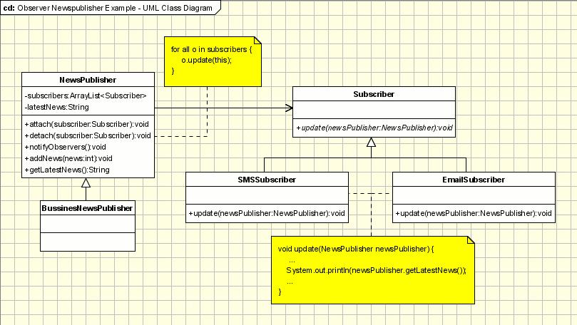
Observer – Motivation (continued)

Slide 132
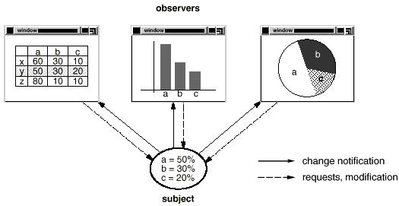
Observer – Motivation (continued)
Example 2: Separate the presentational aspects of the user interface from the underlying application data

Slide 133
Observer - Applicability
Use the Observer pattern when:
an abstraction has two aspects, one dependent on the other
a change to one object requires changing others
an object should be able to notify other objects without making assumptions about who these objects are

Slide 134
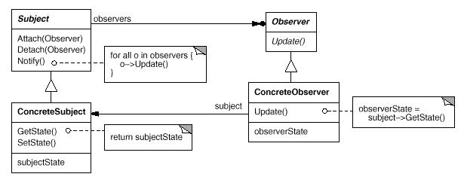
Observer – Participants
Subject (NewsPublisher)
knows its observers
provides an interface for attaching and detaching Observer objects
Observer (Subscriber)
defines an updating interface

Slide 135
Observer – Participants (continued)
ConcreteSubject (BusinessNewsPublisher)
sends a notification to its observers when its state changes
ConcreteObserver (SMSSubscriber, EmailSubscriber)
maintains a reference to a ConcreteSubject object
implements the Observer updating interface to keep its state consistent with the subject's

Slide 136
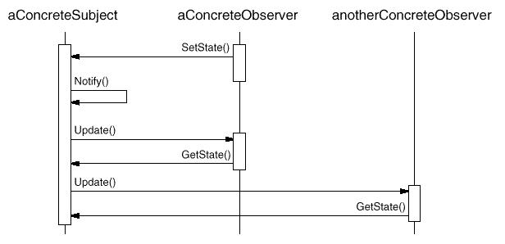
Observer - Collaborations
A change request may come from a Concrete Observer
ConcreteSubject notifies its observers whenever a change occurs
ConcreteObserver queries the subject for information

Slide 137
Observer – Consequences
Abstract coupling between Subject and Observer
All a subject knows is that it has a list of observers
Subject doesn't know the concrete class of any observer
Coupling between subjects and observers is abstract and minimal
Support for broadcast communication
Notification is broadcast automatically to all interested objects that subscribed to it
Subject doesn't care how many interested objects exist
Freedom to add and remove observers at any time

Slide 138
Command (behavioral)

Slide 139
Command
Intent
Encapsulate a request as an object and support undoable operations

Slide 140
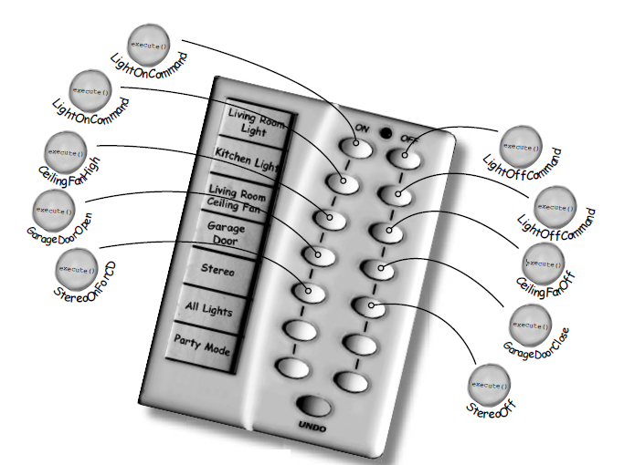
Command – Motivation
Fancy Remote Control

Slide 141
Command – Motivation (continued)

Slide 142
Command – Motivation 2
Job Queue

Slide 143
Command - Applicability
Use the Command pattern when
parameterize objects by an action to perform (as RemoteControl was)
support undo
queue, and execute requests at different time

Slide 144
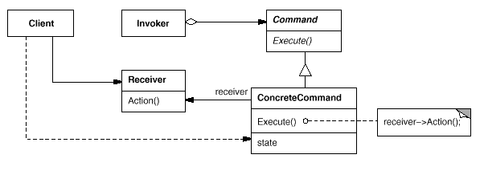
Command - Participants
Command
declares an interface for executing an operation
Optionally it can also declare undo operation
ConcreteCommand (LightOnCommand)
implements Execute by invoking the corresponding operation(s) on Receiver.
Client (RemoteLoader)
creates a ConcreteCommand object and sets its receiver.

Slide 145
Command - Participants
Invoker (RemoteControl)
asks the command to carry out the request
Receiver (Light)
knows how to perform the operations associated with carrying out a request. Any class may serve as a Receiver.

Slide 146
Command - Collaborations
The client creates a ConcreteCommand object and specifies its receiver.
An Invoker object stores the ConcreteCommand object.
The invoker issues a request by calling Execute on the command. (When commands are undoable, ConcreteCommand stores state for undoing the command prior to invoking Execute)
The ConcreteCommand object invokes operations on its receiver to carry out the request.

Slide 147
Imagine

Slide 148
Adapter (structural)

Slide 149
Adapter
Intent
Convert the interface of a class into another interface clients expect
Adapter lets classes work together that could not otherwise because of incompatible interfaces
Also Known As
Wrapper

Slide 150
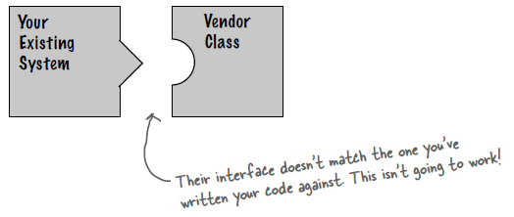
Adapter - Motivation
Sometimes a toolkit class that‘s designed for reuse is not reusable because its interface does not match the domain-specific interface an application requires

Slide 151
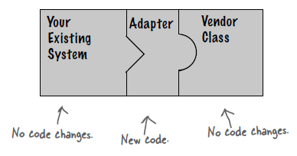
Adapter - Motivation

Slide 152
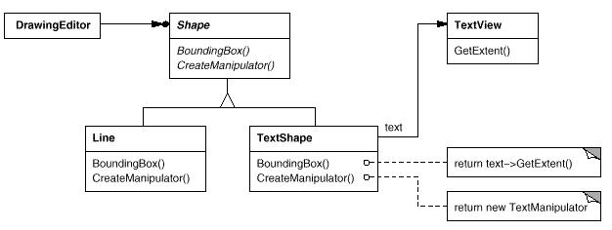
Adapter – Motivation (continued)

Slide 153
Adapter - Applicability
Use the Adapter pattern when
You want to use an existing class, and its interface does not match the one you need

Slide 154
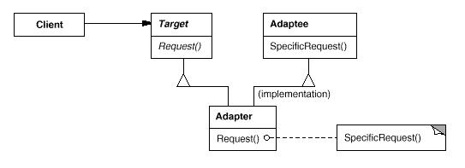
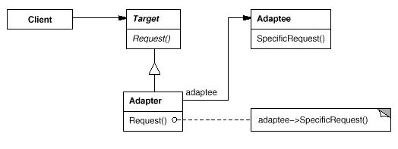
Adapter - Structure
Class Adapter
Object Adapter

Slide 155
Adapter - Participants
Target (Shape)
defines the domain-specific interface that Client uses
Client (DrawingEditor)
collaborates with objects conforming to the Target interface
Adaptee (TextView)
defines an existing interface that needs adapting
Adapter (TextShape)
adapts the interface of Adaptee to the Target interface

Slide 156
Adapter – Collaborations
Clients call operations on an Adapter instance
In turn, the adapter calls Adaptee operations that carry out the request.

Slide 157
Imagine

Slide 158
Facade (structural)

Slide 159
Facade
Intent
Defines a higher-level interface that makes a complex subsystem easier to use

Slide 160
Facade - Motivation
Home Theater

Slide 161
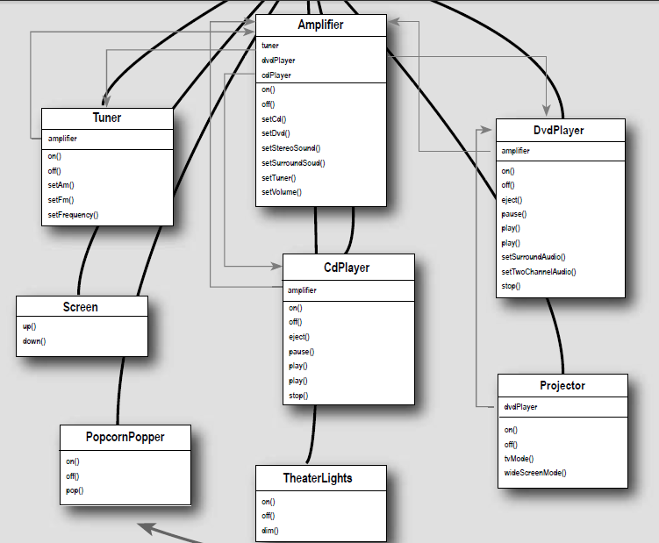
Facade – Motivation (continued)

Slide 162
Facade – Motivation (continued)

Slide 163
Facade - Applicability
Use the Facade pattern when
you want to provide a simple interface to a complex subsystem

Slide 164
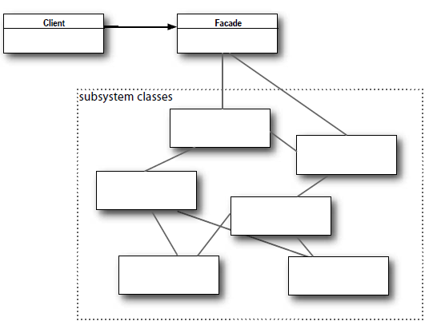
Facade - Participants
Facade (HomeTheaterFacade)
delegates client requests to appropriate subsystem objects
Subsystem classes (Amplifier, Tuner, Dvd etc.)
implement subsystem functionality

Slide 165
Facade - Collaborations
Clients communicate with the subsystem by sending requests to Facade
Facade forwards requests to the appropriate subsystem object(s)
Clients that use the facade don't have to access its subsystem objects directly

Slide 166
Facade – Consequences
It shields clients from subsystem components
It promotes weak coupling between the subsystem and its clients
lets you vary the components of the subsystem without affecting its clients
It doesn't prevent applications from using subsystem classes if they need to

Slide 167
Singleton (creational)

Slide 168
Singleton
Intent
Ensure a class only has one instance, and provide a global point of access to it

Slide 169
Singleton - Motivation
It's important for some classes to have exactly one instance
Examples: one president, one engine, one printer etc.

Slide 170
Singleton - Applicability
Use the Singleton pattern when
there must be exactly one instance of a class, and it must be accessible to clients from a well-known access point
when the sole instance should be extensible by subclassing, and clients should be able to use an extended instance without modifying their code

Slide 171
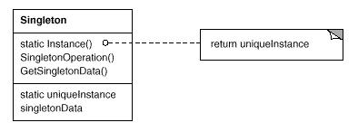
Singleton - Participants
Singleton
Defines an Instance operation that lets clients access its unique instance
Instance is a class operation
Responsible for creating its own unique instance

Slide 172
Singleton - Collaborations
Clients access a Singleton instance solely through Singleton's Instance operation.

Slide 173
Singleton – Consequences
Controlled access to sole instance
Permits a variable number of instances

Slide 174
Singleton - Implementation
Threading issues
Subclassing

Slide 175
Bridge (structural)

Slide 176
Bridge
Intent
Decouple an abstraction from its implementation so that the two can vary independently
Publish interface in an inheritance hierarchy, and bury implementation in its own inheritance hierarchy

Slide 177
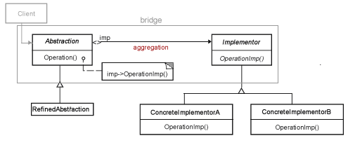
Bridge – Structure
Abstraction
Defines the abstract interface
Maintains the Implementor reference
RefinedAbstraction
extends the interface defined by Abstraction

Slide 178
Bridge – Structure
Implementor
Defines the interface for implementation classes
ConcreteImplementor
Implements the Implementor interface

Slide 179
Bridge - Applicability
Use the Bridge pattern when
you want run-time binding of the implementation
you have a proliferation of classes resulting from a coupled interface and numerous implementations
you want to share an implementation among multiple objects
you need to map orthogonal class hierarchies

Slide 180
Bridge - Consequences
Decoupling the object’s interface
Improved extensibility (you can extend (i.e. subclass) the abstraction and implementation hierarchies independently)
Hiding details from clients

Slide 181
Wrap Up

Slide 182
Wrap Up
Applicable in all stages of the OO lifecycle
Design & reviews
Realization & documentation
Reuse & refactoring
Permit design at a more abstract level
Treat many class/object interactions as a unit
Often beneficial after initial design
Targets for class refactoring
Variation-oriented design
Consider what design aspects are variable
Identify applicable pattern(s)
Vary patterns to evaluate tradeoffs
Repeat

Slide 183
Conclusion
Test-Driven Development
Patterns can be unit tested
Tests are your first client, listen to your tests
Identify code that can’t be tested
Identify patterns and refactor
Patterns will grow in order satisfy your tests
Design patterns promote
design reuse
uniform design vocabulary
understanding, restructuring
a new way of thinking about design

Slide 184
Thank You

Slide 185
Acknowledgments
Significant portions of this presentation were adapted from original works by:
Design Patterns by Erich Gamma, Richard Helm, Ralph Johnson, and John Vlissides (the Gang of Four)
Designing with Patterns by John Vlisside
Head First Design Patterns, O’Reilly
References:
http://sourcemaking.com/design_patterns
http://pragprog.com/resources
http://www.oodesign.com/
http://www.aristeia.com/Papers/DDJ_Jul_Aug_2004_revised.pdf\
Creativity: Flow and the Psychology of Discovery and Invention by Mihaly Csikszentmihalyi
Chess photo http://en.wikipedia.org/wiki/Chess
Piano http://s802.photobucket.com/user/Aubryknight/media/PianoRose12.jpg.html
Katana http://img3.wikia.nocookie.net/__cb20140329143125/bleach-rp/images/4/4e/KanamiZan.jpg
Horse http://ennete.deviantart.com/art/Drawing-horse-with-rider-214705393

